Slide 1
Level 1 Chapter 4: Data Integration and Processing

Slide 2
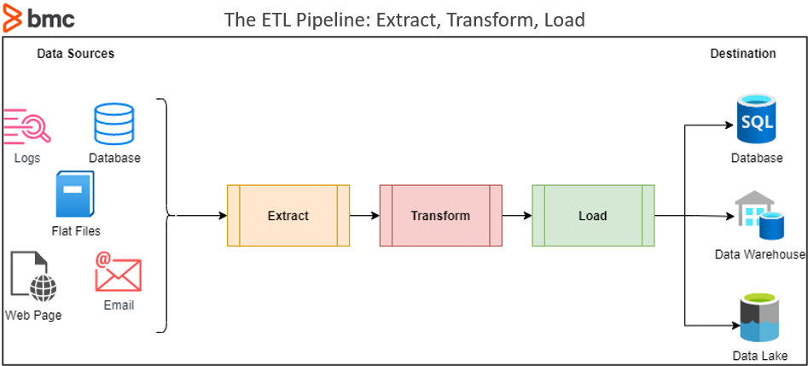
Basic concepts of ETL (Extract, Transform, Load)

Slide 3
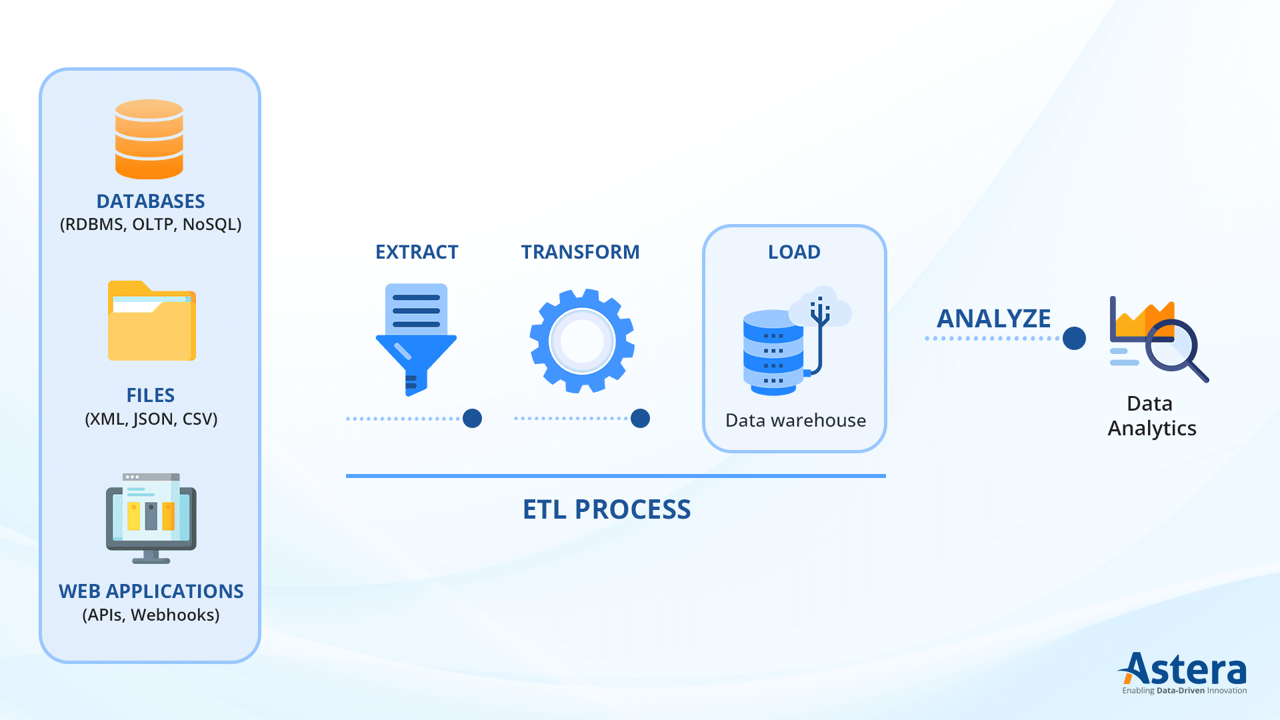
Basic concepts of ETL (Extract, Transform, Load)

Slide 4
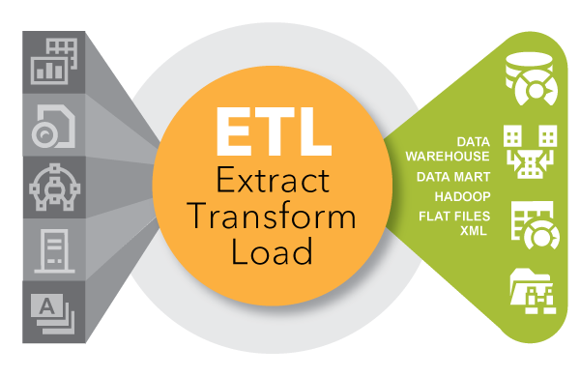
Basic concepts of ETL (Extract, Transform, Load)

Slide 5
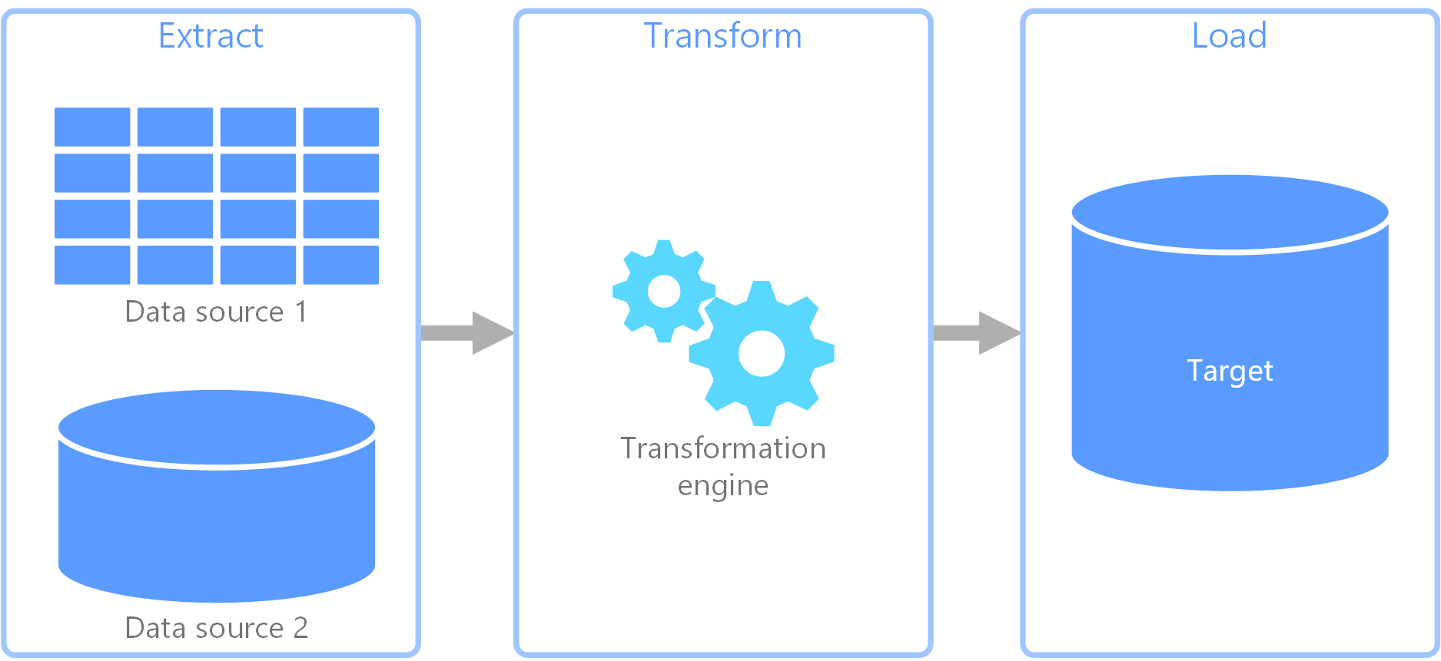
Basic concepts of ETL (Extract, Transform, Load)
Extract, transform, load (ETL) is a data pipeline used to collect data from various sources. It then transforms the data according to business rules, and it loads the data into a destination data store.
The transformation work in ETL takes place in a specialized engine, and it often involves using staging tables to temporarily hold data as it is being transformed and ultimately loaded to its destination.

Slide 6
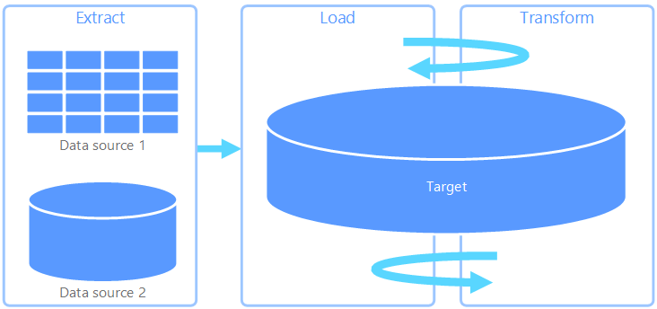
Basic concepts of Extract, load, transform (ELT)
Extract, load, transform (ELT) differs from ETL solely in where the transformation takes place. In the ELT pipeline, the transformation occurs in the target data store. Instead of using a separate transformation engine, the processing capabilities of the target data store are used to transform data.
This simplifies the architecture by removing the transformation engine from the pipeline. Another benefit to this approach is that scaling the target data store also scales the ELT pipeline performance. However, ELT only works well when the target system is powerful enough to transform the data efficiently.

Slide 7
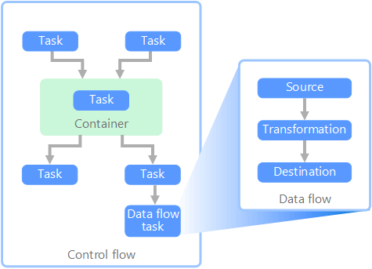
Data flow and control flow
Azure In the context of data pipelines, the control flow ensures the orderly processing of a set of tasks. To enforce the correct processing order of these tasks, precedence constraints are used. You can think of these constraints as connectors in a workflow diagram, as shown in the image below. Each task has an outcome, such as success, failure, or completion. Any subsequent task does not initiate processing until its predecessor has completed with one of these outcomes.
Control flows execute data flows as a task. In a data flow task, data is extracted from a source, transformed, or loaded into a data store. The output of one data flow task can be the input to the next data flow task, and data flows can run in parallel. Unlike control flows, you cannot add constraints between tasks in a data flow. You can, however, add a data viewer to observe the data as it is processed by each task.

Slide 8
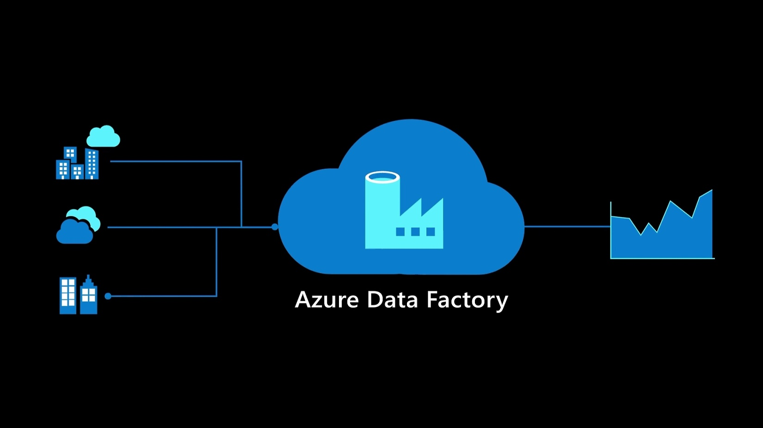
Overview of Azure Data Factory
Integrate all your data with Azure Data Factory, a fully managed, serverless data integration service. Visually integrate data sources with more than 90 built-in, maintenance-free connectors at no added cost. Easily construct ETL (extract, transform, and load) and ELT (extract, load, and transform) processes code-free in an intuitive environment or write your own code.
Then deliver integrated data to Azure Synapse Analytics to unlock business insights.

Slide 9
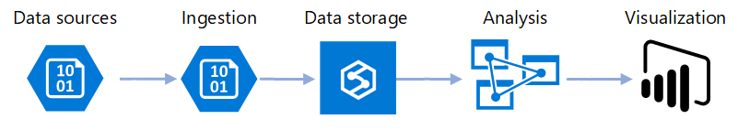
Overview of Azure Data Factory
Microsoft Azure Data Factory is a fully managed, serverless data integration service. It enables you to visually integrate data sources with more than 90 built-in, maintenance-free connectors.

Slide 10
Overview of Azure Data Factory: Example scenario
Let's imagine you work for a gaming company, where you gather data logs that are generated during gaming sessions. If you could analyze this log data, you'd be able to get insights into customer preferences, demographics, and usage behavior. People in your sales team have expressed an interest in up-selling and cross-selling opportunities, and wonder whether these data logs might contain helpful information.
The development and technical teams are interested in learning about potential problems with the gaming experience, and how new features might help solve those problems.
Your problem is that to successfully analyze the data in the logs, you also need to reference data that's stored in on-premises locations. This data includes customer information, game information, and marketing-campaign information. Your company has stored your gaming log data in a cloud data store and wants you to use all the on-premises data as well.

Slide 11
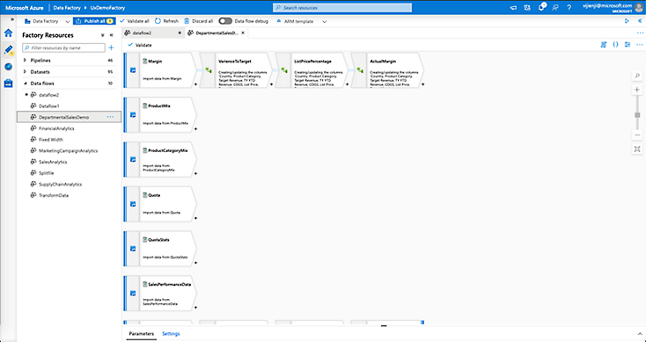
Overview of Azure Data Factory
Integrate Data Factory provides a data integration and transformation layer that works across your digital transformation initiatives.
Enable citizen integrators and data engineers to drive business and IT-led Analytics/BI.
Prepare data, construct ETL and ELT processes, and orchestrate and monitor pipelines code-free. The managed Apache Spark™ service takes care of code generation and maintenance.
Transform faster with intelligent intent-driven mapping that automates copy activities.

Slide 12
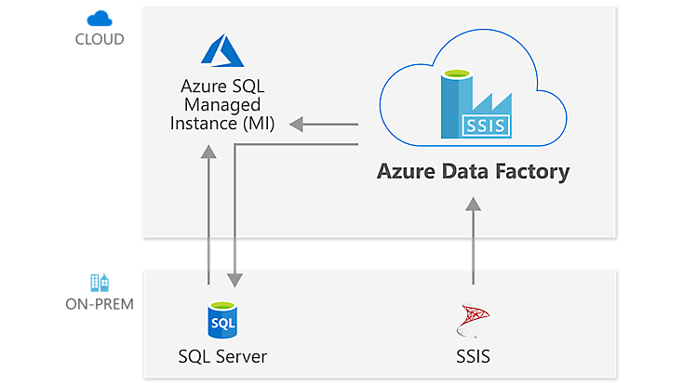
Overview of Azure Data Factory: Rehost and extend SSIS in a few clicks
Azure Data Factory can help organizations looking to modernize SSIS.
Gain up to 88 percent cost savings with Azure Hybrid Benefit.
Enjoy the only fully compatible data integration service that makes it easy to move all your SSIS packages to the cloud.
Learn how easy migration is with the deployment wizard and ample how-to documentation.
Realize your vision for hybrid big data and data warehousing initiatives by using Data Factory cloud data pipelines.

Slide 13
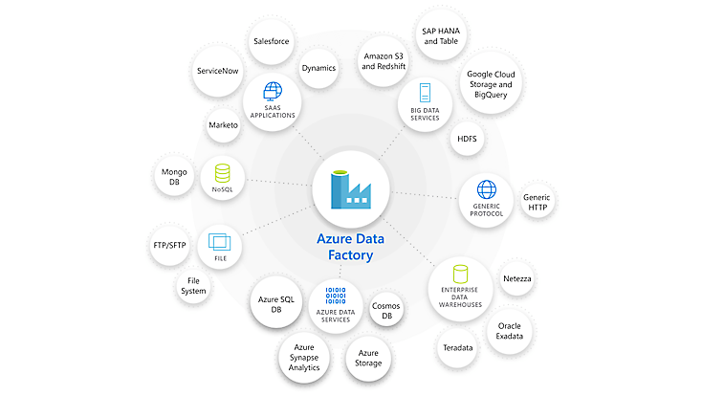
Overview of Azure Data Factory: Ingest all your data with built-in connectors
Ingesting data from diverse and multiple sources can be expensive and time consuming and may require multiple solutions. Azure Data Factory offers a single, pay-as-you-go service.
Choose from more than 90 built-in connectors to acquire data from big data sources such as Amazon Redshift, Google BigQuery, and HDFS; enterprise data warehouses such as Oracle Exadata and Teradata; SaaS apps such as Salesforce, Marketo, and ServiceNow; and all Azure data services.
Use the full capacity of underlying network bandwidth, up to 5 Gbps throughput.

Slide 14
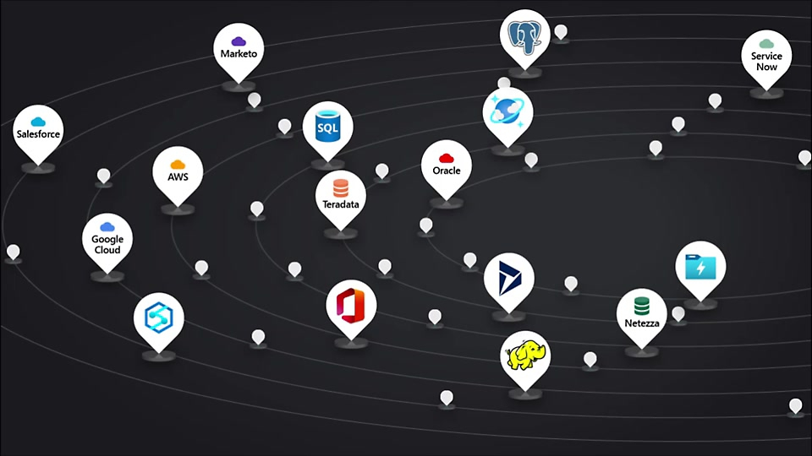
Overview of Azure Data Factory: Hybrid data integration, simplified
In today’s data-driven world, big data processing is a critical task for every organization. To unlock transformational insights, data engineers need services that are built to simplify ETL and handle the complexities and scale challenges of big data integration.
With Azure Data Factory, it’s fast and easy to build code-free or code-centric ETL and ELT processes.

Slide 15
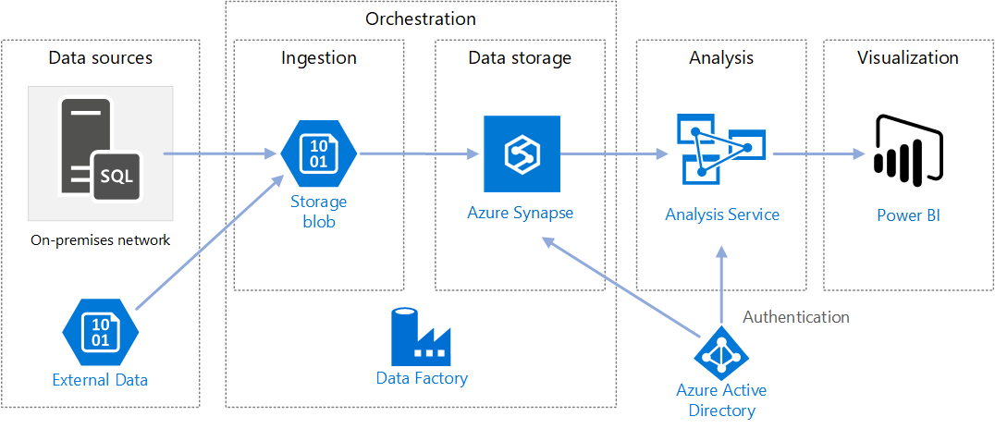
How Azure Data Factory can help with data analytics
Build complex ETL processes. These processes can transform data visually by using either data flows or compute services such as:
Azure HDInsight Hadoop
Azure Databricks
Azure SQL Database
Publish this transformed
data to data stores for
business intelligence
apps to consume.

Slide 16

How Azure Data Factory works
Azure Data Factory is a collection of interconnected systems that combine to provide an end-to-end data analytics platform. In this unit, you'll learn about the following Azure Data Factory functions:
Connect and collect
Transform and enrich
Continuous integration and delivery (CI/CD) and publish
Monitoring
You'll also learn about the key components of Azure Data Factory. These are:
Pipelines
Activities
Datasets
Linked services
Data flows
Integration runtimes

Slide 17
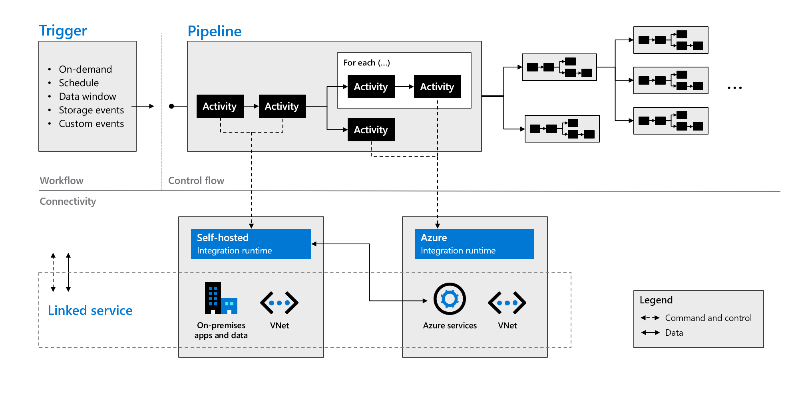
How Azure Data Factory works

Slide 18
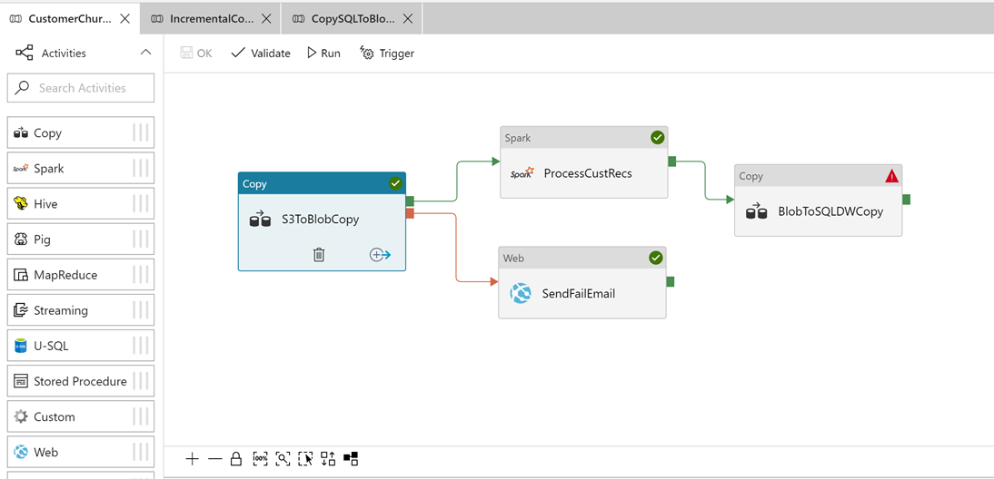
How Azure Data Factory works: Do you have the coding resources needed?

Slide 19
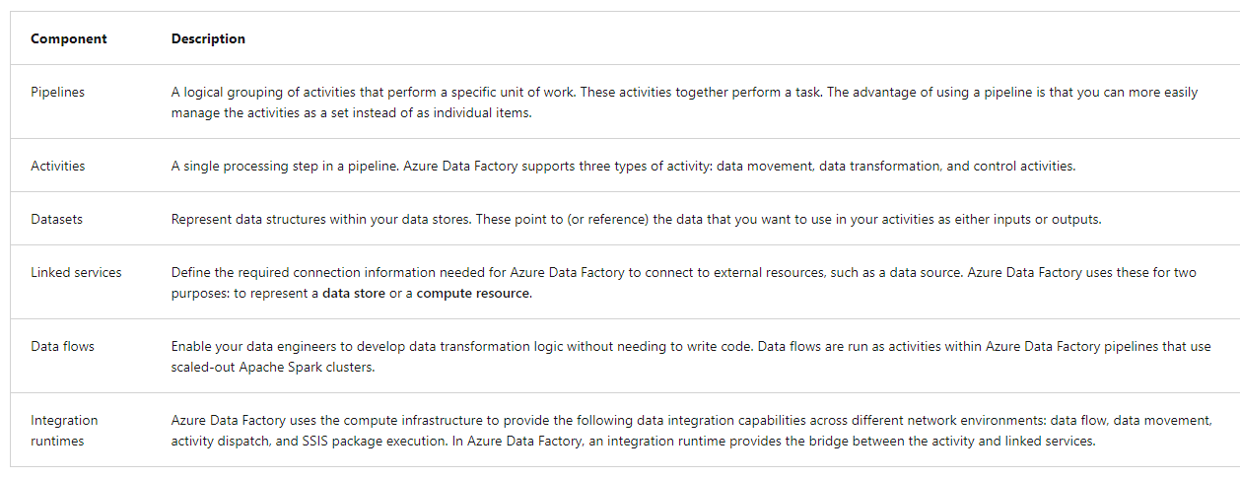
Azure Data Factory components

Slide 20
Thanking you !!!
Any Question !!!!

